Slide 1
Pinpointed renovations
Campus Kirchberg
Branca Delmonte
branca.delmonte@uni.lu
July 8, 2025
Notes:
Good afternoon and thank you for being here today. Now considering the very important topic raised by prof. Maas concerning the gap between simulated and measured energy consumption in buildings, now I invite you to dive into what we call pinpointed renovations, and understand their role in decarbonizing existing buildings, based on this study case of this very campus where we are today.

Slide 2
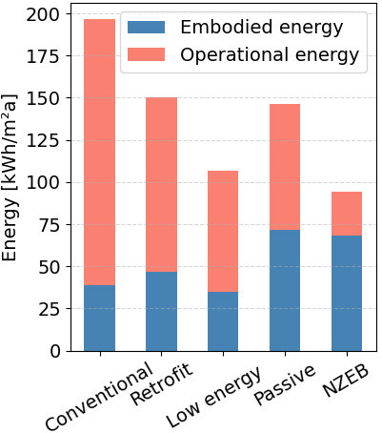
Motivation
Optimal operation
&
Pinpointed renovations
A. D. Dilsiz, J. Felkner, G. Habert, and Z. Nagy, “Embodied versus operational energy in residential and commercial buildings: Where should we focus?,” in Journal of Physics: Conference Series, Institute of Physics Publishing, Nov. 2019. doi: 10.1088/1742-6596/1343/1/012178
2
Notes:
The motivation for such approach comes from the trend of increasing embodied energy in buildings, to reduce their operational consumption, and the need to compare the added energy during renovations, to the savings over the life cycle. Besides considering the already discussed performance gap.
This presentation shows a combination of optimized operation with pinpointed renovations, to reach carbon savings in educational buildings and contribute to climate protection.

Slide 3
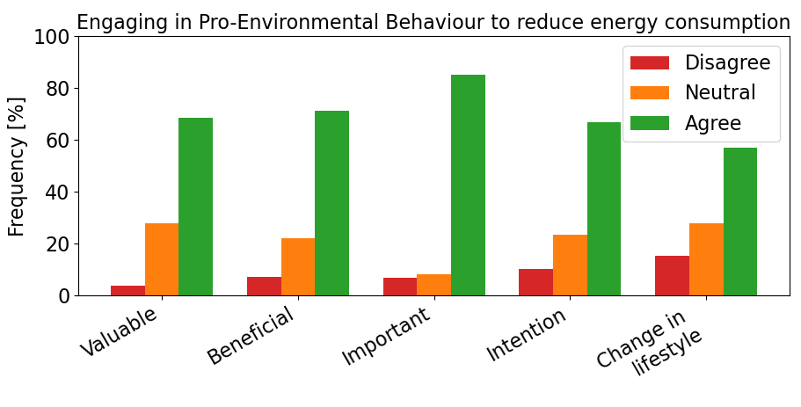
Behavioural approach
Stakeholders
Director
Teachers
Students
Building owner
Parents
Staff
Service providers
Stakeholders
Complex chain
Positive attitude
3
Notes:
In order to identify energy and carbon-savings opportunities we need to understand the building. It is necessary to evaluate its physical properties, but above all how the building is used, operated and managed.
Educational buildings involve a complex stakeholder chain with different objectives, roles and expectations. Students represent the major users, yet with the lowest control level with regards to the operation, which is controlled by staff and service providers, but not always in communication.
All these aspects needs to be considered when defining strategies to reduce energy consumption, to find the best fit.
The good news is that according to the surveys that we have distributed, most users consider engaging in measures to reduce energy consumption valuable, beneficial and important. They state that they have the intention of engaging, and that they are open to changes in lifestyle.

Slide 4
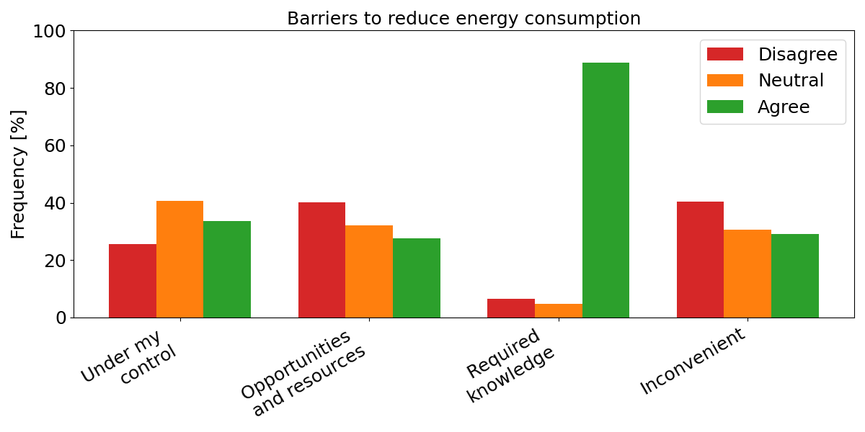
Behavioural approach
- Barriers
Users:
Energy managers:
4
Notes:
The surveys also evaluated the barriers for implementing measures, where the users pointed out the need for knowledge, while energy managers mentioned resources constraints, either in terms of budget or staff. They also mentioned the need for clear sustainability indicators to help overcome financial barriers during the decision-making process.

Slide 5
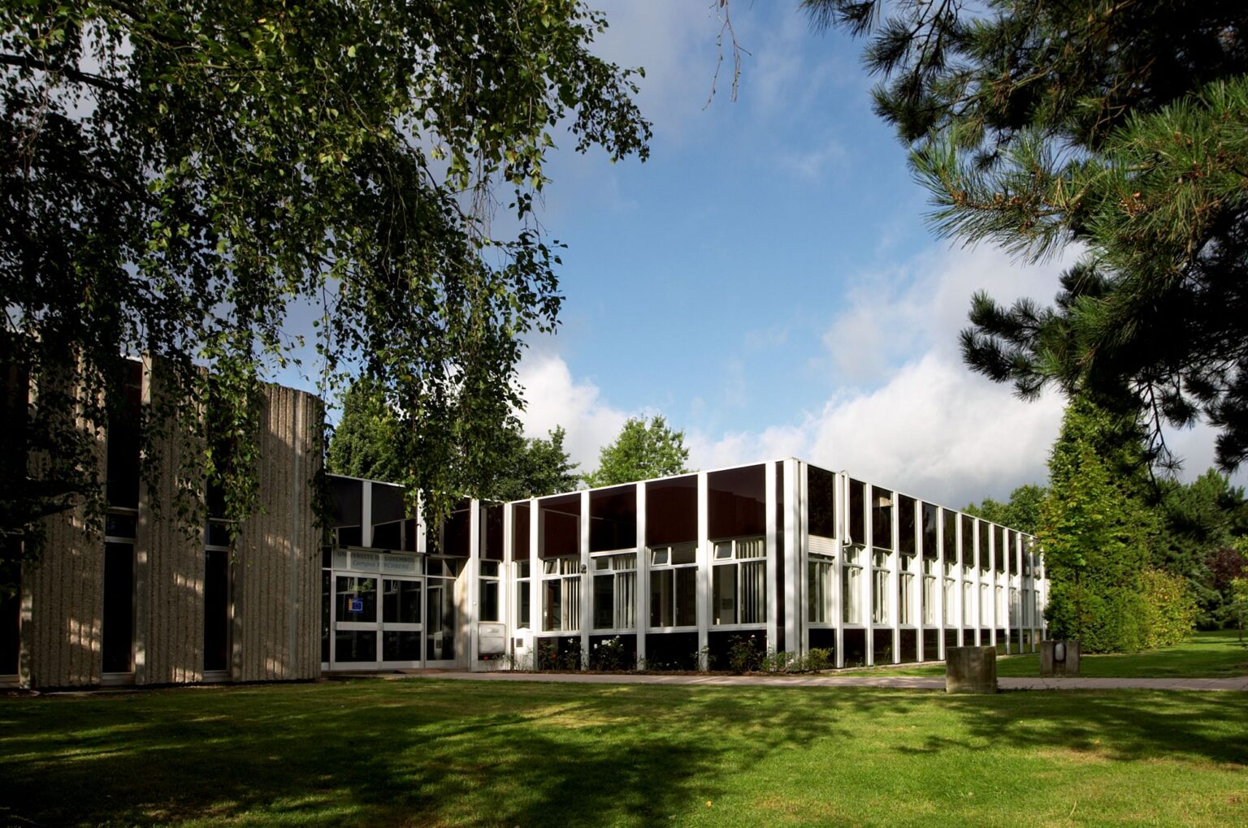
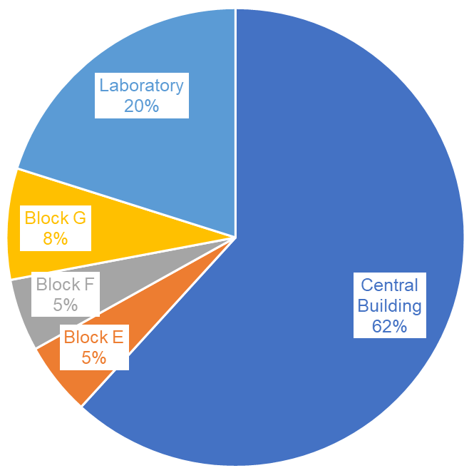
Energy Audit
Year of construction: 1974
Heated gross floor area: 23,480 m²
Heating system: District heating with a combined heat and power system operation with a mix between gas and wood pellets
Campus Kirchberg
5
Notes:
Now to identify measures which are adapted to the building, an energy audit is necessary, in this case focused on the thermal consumption.
Here we are analysing this campus, which is composed by 5 buildings, with Central Building and Laboratory being built in the seventies.
The heat comes from a district heating system and it’s produced cogeneration systems, running on natural gas and wood pellets.

Slide 6
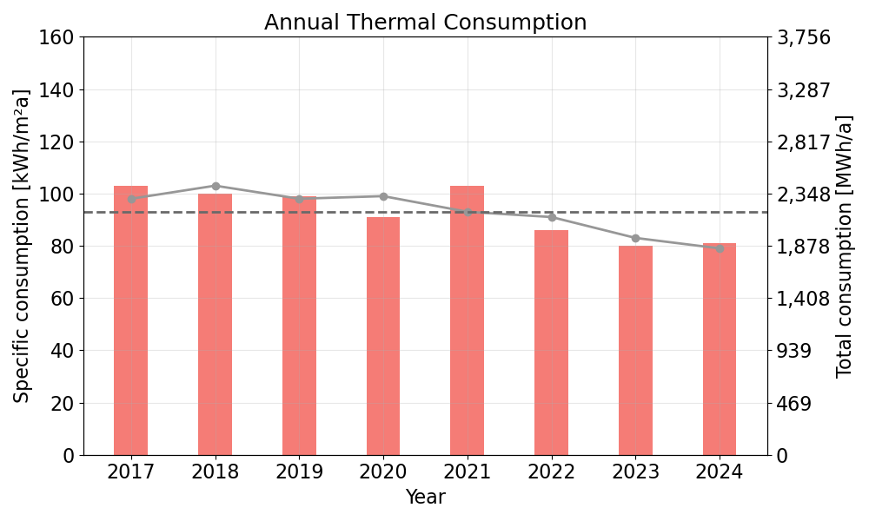
Energy Audit
Reduced operational mode over Christmas holidays
Balancing radiators
Different setpoints for common areas
Reduced temperatures
6
Notes:
The analysis of the heat consumption shows a clear reduction over the years, specially marked in the normalised curve regarding the heating degree days.
The reduction obtained in 2023 refers to the balancing of the distribution system, the adoption of lower temperatures in common areas, and a general reduction of temperatures in the building, which led to uncomfortable conditions for users.
The further reduction in 2024 refers to the adoption of reduced operational modes during Christmas holidays, following the reduction in the building occupation.

Slide 7
Energy Audit
Heat losses
Technical losses
7
Notes:
The Central Building represents the highest consumer among the five buildings, while the thermal model of this building shows that windows, roof and envelope represent 70% of the thermal losses. This gives as an indication on where the focus our efforts!

Slide 8
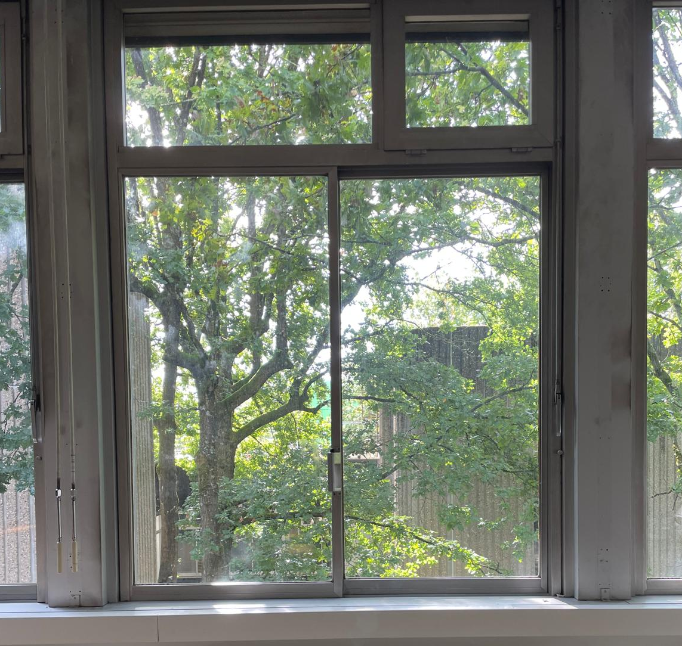
Insulation and improving air tightness of windows
Aluminium frames with high thermal conductivity
&
Air gaps
8
Notes:
The windows in this campus have aluminium frames with high thermal conductivity, which besides leading to high thermal losses, also represent a source of discomfort for users, besides the air gaps from the old seals and warped frames.

Slide 9
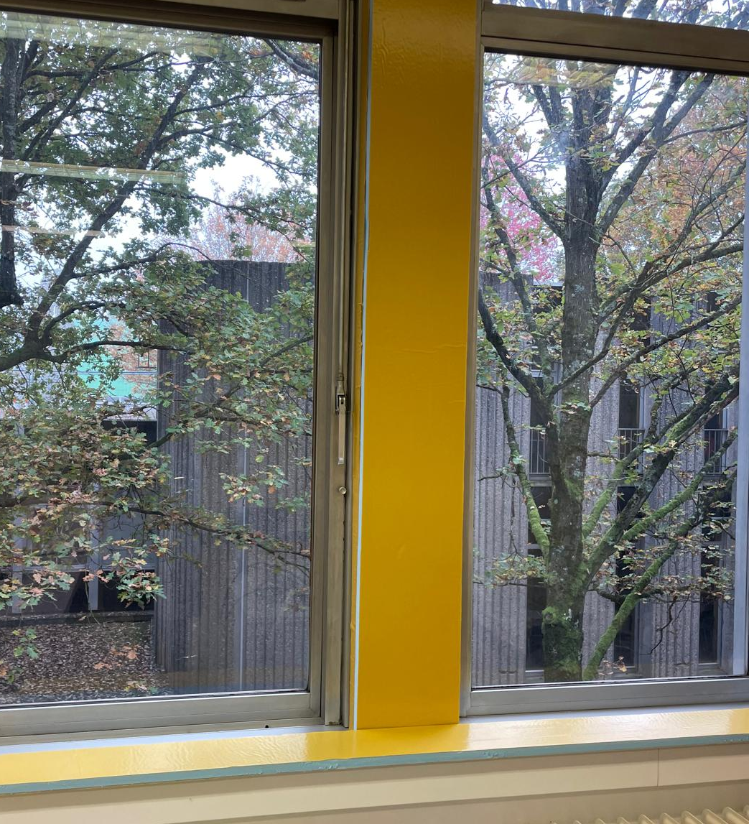
Insulation and improving air tightness of windows
Before
After
9
Notes:
The proposed approach was to add a 2 cm XPS board to the window frame, as showed in the pictures, which also contributed to closing some gaps from old internal blinds systems that are no longer used, but represented a source of discomfort and heat losses.

Slide 10
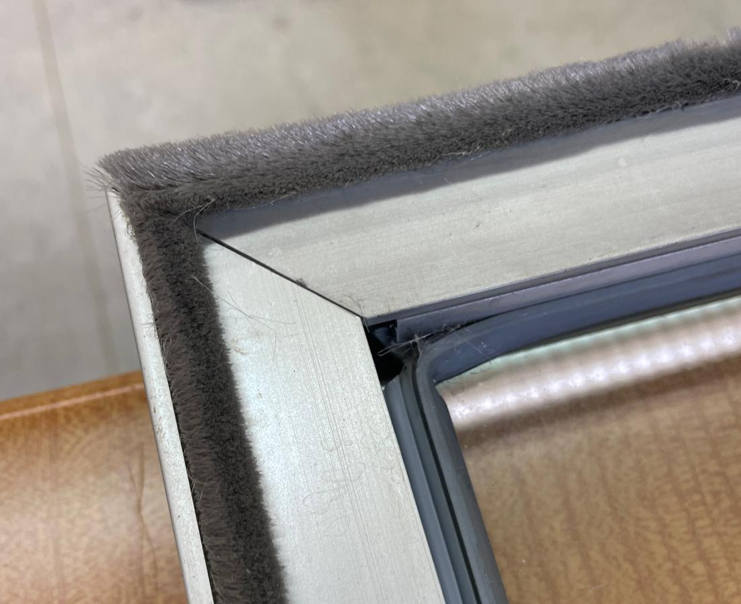
Insulation and improving air tightness of windows
Repair of pane frames
Improving air tightness
Replacement of seals
10
Notes:
Furthermore, the seals were replaced and the pane frames were repaired, improving the air tightness of the window.

Slide 11
Insulation and improving air tightness of windows
Before
After
Window side view with open blind
U-value: 3.0 W/m²K
Window side view with insulated frame and closed blind
U-value: 1.7 W/m²K
11
Notes:
Our measurements showed an improvement from the original window with a u-value of 3 W/m2K to a u-value of 1.7, with the addition of the insulation to the window frame, and the adoption of closed blinds during the night to create an air layer which works as extra insulation layer for the glass.

Slide 12
Insulation and improving air tightness of windows
Original aluminium frame & open blinds
U-value: 3 W/m²K
Renovation - Insulated aluminium frame & closed blinds
U-value: 1.7 W/m²K
Replacement
New window
U-value: 0.9 W/m²K
Energetic
Carbon emissions
Economic
Renovation
Embodied energy:
Operational energy:
Compensation time:
Replacement
Embodied energy:
Operational energy:
Compensation time:
+519 MWh
-95 MWh/a
5 years
+1105 MWh
-283 MWh/a
4 years
Renovation
Embodied carbon:
Operational carbon:
Compensation time:
Replacement
Embodied carbon:
Operational carbon:
Compensation time:
+145 tonCO₂
-29 tonCO₂/a
5 years
+309 tonCO₂
-56 tonCO₂/a
6 years
Renovation
Investment:
Operational savings:
Payback time:
Replacement
Investment:
Operational savings:
Payback time:
-545,000 €
+14,500 €/a
38 years
-1,722,000 €
+43,500 €/a
40 years
12
Notes:
The results for this measure are presented by comparing the original window (before renovation) with open blinds and a u-value of 3 W/m2K, with the renovation scenario, with the insulated aluminium frame and the closed blinds during the night, and the second scenario referring to the full replacement of the windows.
These two scenario are compared to the original window in terms of energetically, in terms of carbon emissions and economically.
In terms of energy, both the scenarios of renovation, and the replacement of the windows shows a compensation time for the added primary embodied energy of 4 to five years, while the carbon emissions from the renovations, or the new windows are compensated in 5 to 6 years. Finally, the economic assessment shows longer payback times for both scenarios, with the investment in renovation representing nearly 1/3 of the full replacement of the windows, which could help to overcome barriers for implementation.

Slide 13
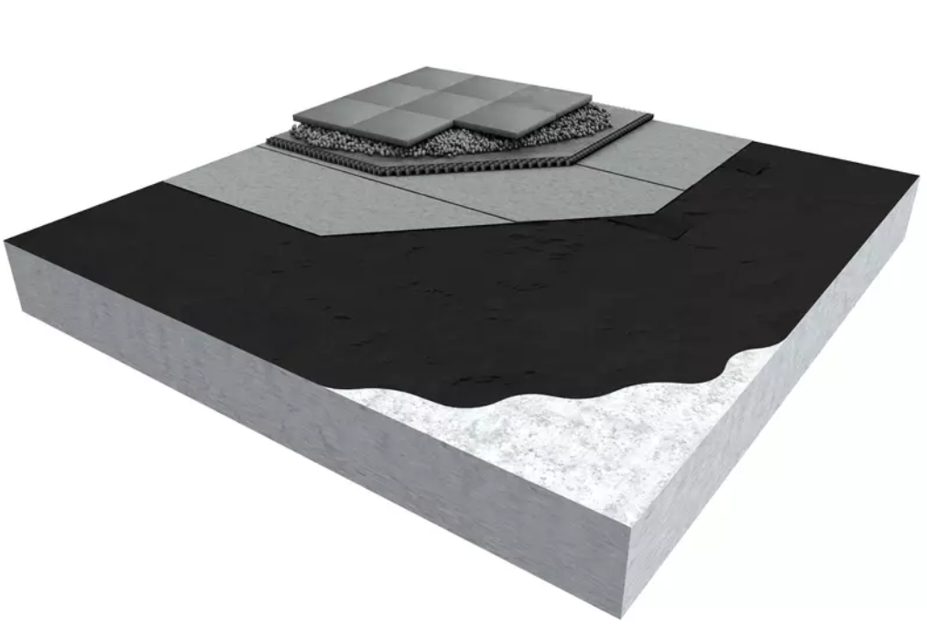
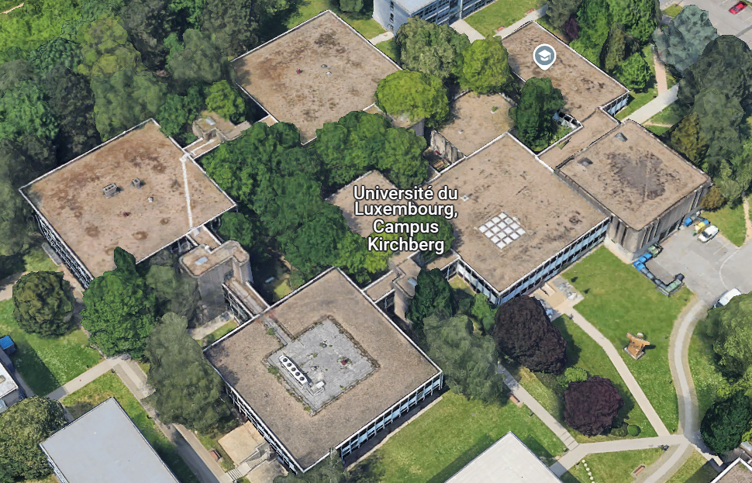
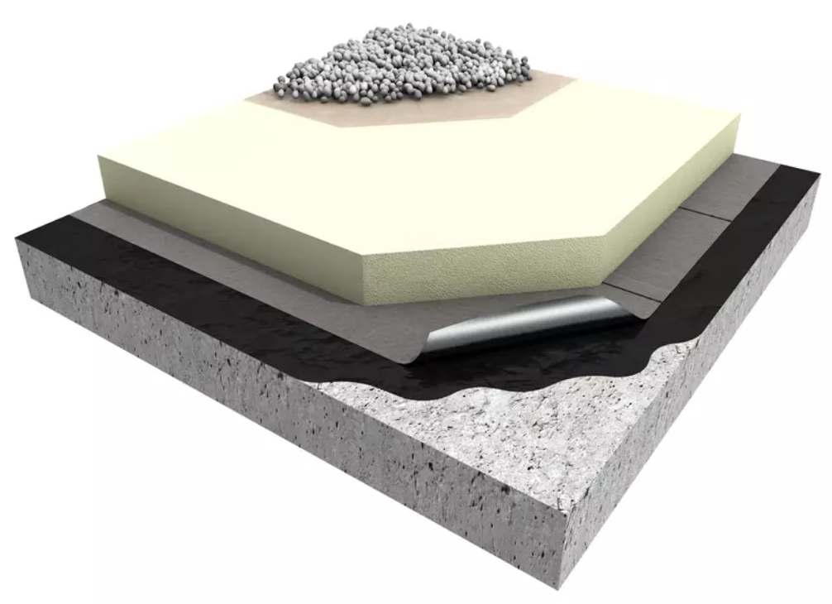
Inverted roof insulation
Before
After
13
Notes:
With regards to the roof, considering the existing flat roof of the campus, covered with gravel, the proposed intervention refers to the so-called inverted roof, adding an extra insulation layer between the existing waterproof system and the gravel, to improve the thermal resistance of the building element, which currently only counts with a 5 cm of an insulation foam.
This is a quite simple measure, which only requires the temporary removal of the gravel layer to place the insulation, to be covered with the same material afterwards, with a special attention to the draining system to avoid water accumulation.

Slide 14
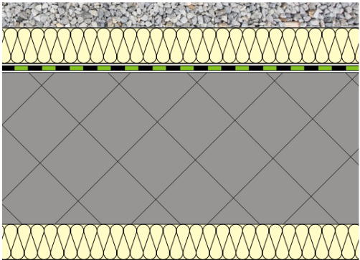
Inverted roof insulation
Inverted roof
Calculated U-value - 50 mm insulation: 0.33 W/m²K
Calculated U-value - 120 mm insulation: 0.20 W/m²K
Original roof
U-value: 0.65 W/m²K
Energetic
Carbon emissions
Economic
50 mm insulation
Embodied energy:
Operational energy:
Compensation time:
120 mm insulation
Embodied energy:
Operational energy:
Compensation time:
+90 MWh
-121 MWh/a
0.7 years
+178 MWh
-168 MWh/a
1.1 years
50 mm insulation
Embodied carbon:
Operational carbon:
Compensation time:
120 mm insulation
Embodied carbon:
Operational carbon:
Compensation time:
+20 tonCO₂
-24 tonCO₂/a
0.9 years
+42 tonCO₂
-33 tonCO₂/a
1.3 years
50 mm insulation
Investment:
Operational savings:
Payback time:
120 mm insulation
Investment:
Operational savings:
Payback time:
-1,026,000 €
+18,600 €/a
55 years
-1,073,000 €
+25,900 €/a
41 years
14
Notes:
The results of such measure is compared to the original roof with a u-value of 0.65 W/m2K. Two scenarios, with insulation thicknesses of 5 and 12 cm with improved u-values of 0.33 and 0.20 W/m2K, are analysed as in the case of the windows, energetically, in terms of carbon emissions and economically.
The results shows the compensation time for added primary embodied energy and related carbon emissions around 1 yea for both scenarios. Furthermore, although the economic analysis show once again long payback times, as small difference is observed in the investment in comparison to the operational energy savings, leading to a better output for the insulation thickness of 12 cm.

Slide 15
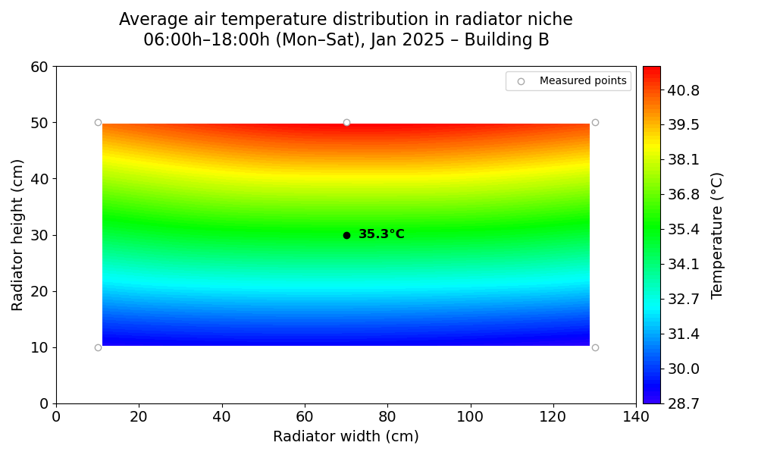
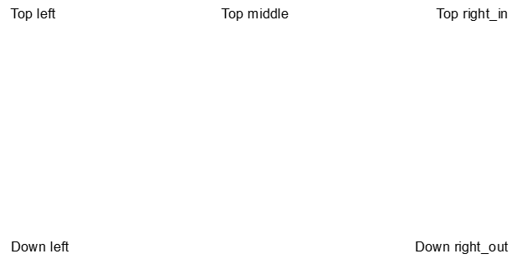
Insulation of radiator niche
Highest temperatures
15
Notes:
Finally, in terms of the envelope, considering that the highest temperatures are happening at the radiator niches, this measure proposes their internal insulation.

Slide 16
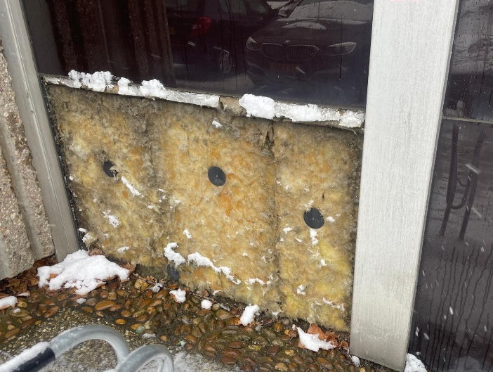
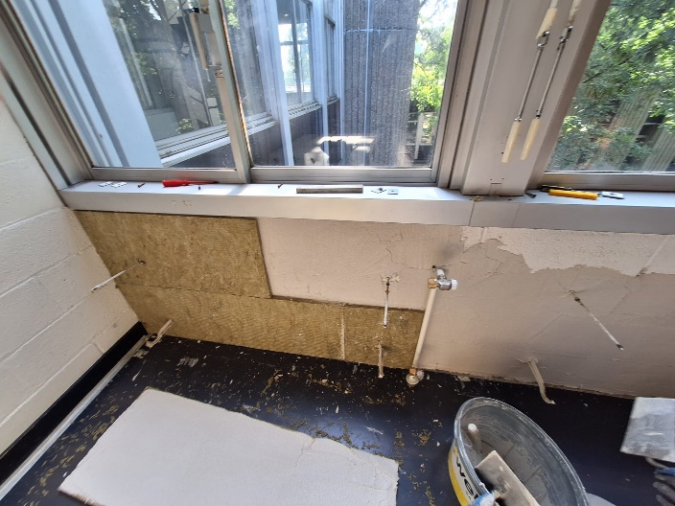
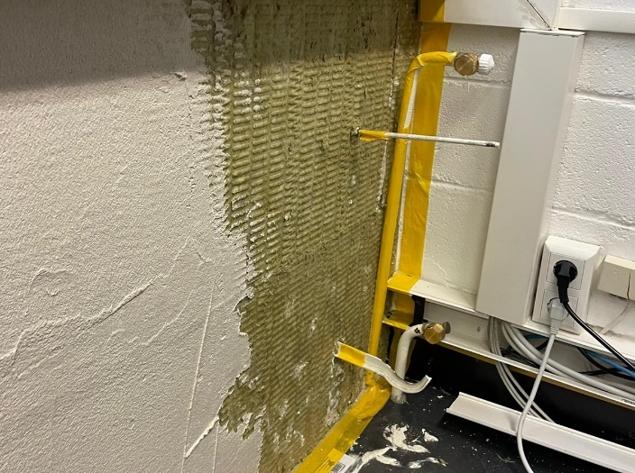
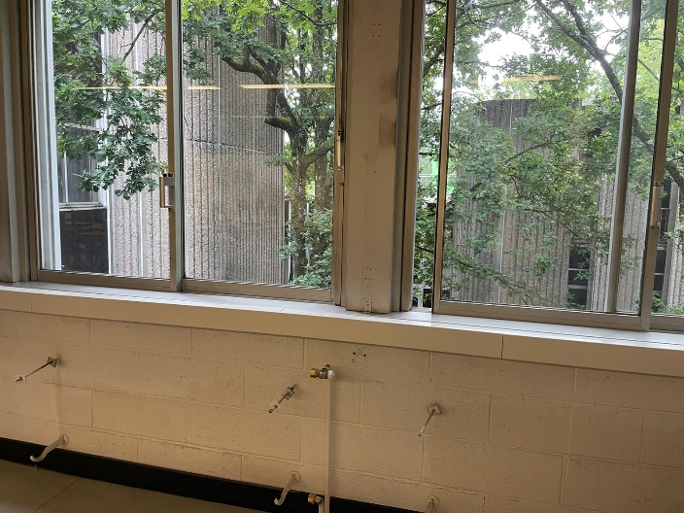
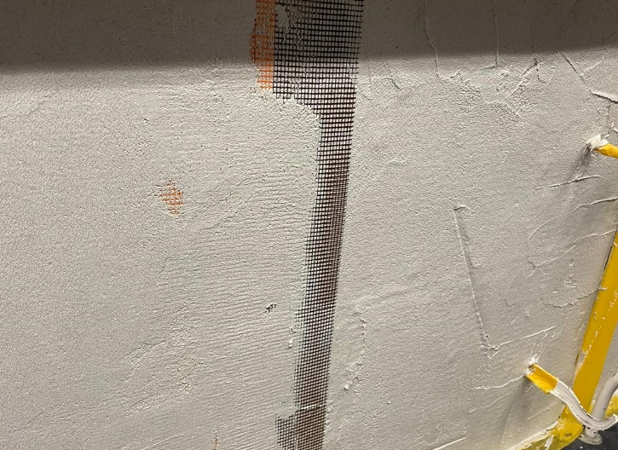
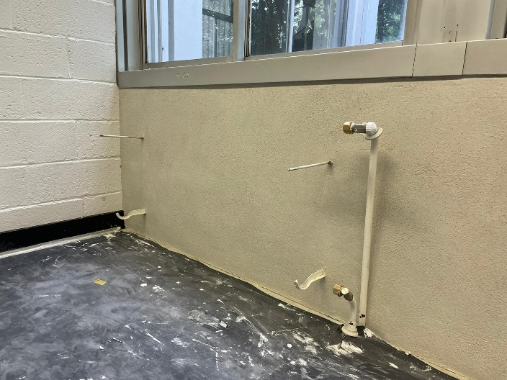
Insulation of radiator niche
Notes:
The original element has 5 cm of rockwool outside, as it can be observed in the first picture, and here an extra insulation layer is added inside. 2 cm boards of rockwool were added to the wall, improving the thermal resistance of this part of the façade where the highest temperature differences between inside and outside are registered.

Slide 17
Insulation of radiator niche
Original façade: U-value: 0.55 W/m²K
Insulated niche: U-value: 0.33 W/m²K
Energetic
Carbon emissions
Economic
+113 MWh
. -9.8 MWh/a
12 years
+34 tonCO₂
-1.9 tonCO₂/a
15 years
20 mm internal insulation
Embodied energy:
Operational energy:
Compensation time:
20 mm internal insulation
Embodied carbon:
Operational carbon:
Compensation time:
-95,671 €
+1,500 €/a
64 years
20 mm internal insulation
Investment:
Operational savings:
Payback time:
17
Notes:
The results shows improvements in the measured u-value from 0.55 to 0.33 after the renovation. The compensation time for the added primary embodied energy and carbon emissions is higher in this case, varying from 12 to 15 years. Also a higher payback time is observed. However, it also represent the lowest investment of the three.

Slide 18
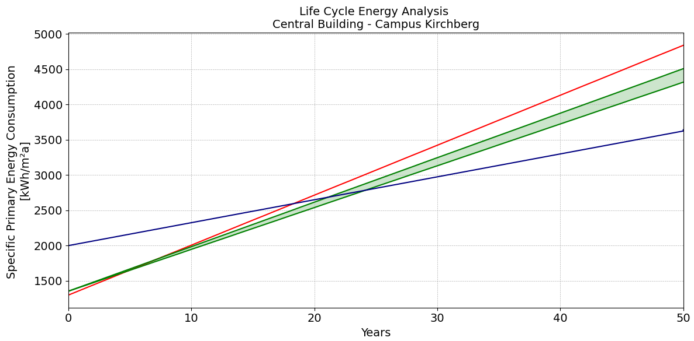
Comparison pinpointed renovations x new building
18 years
between 5 and 7 years
18
Notes:
The comparison of the combined pinpointed renovations with a new building over the building lifecycle shows that considering the already existing embodied energy of the existing building, the added primary embodied energy for the renovations, the added energy is compensated in 5 years, or in 7 years when considering the performance gap. On the other side, the embodied primary energy of a new building, even with the lower operational consumption, is only compensated in 18 years.
This shows us that pinpointed renovations can play an important role in enabling reductions in energy consumption in existing buildings, and reducing carbon emissions in historical buildings, contributing to historical preservation and contributing to the goals to reduce the impacts of climate change, even with limited budgets, in combination with optimal operation.

Slide 19
Thank you!
Any questions?

